Slide 1
Utilities and Insurance
Getting the most for your money

Slide 2
01. Utilities
02. Travel Insurance
Gas, Electric, Broadband. Finding good providers and good prices
How to find cover at a good price and understand cover levels available
03. Defaqto
04.Home Insurance
The importance of checking cover.
.Different types of cover and underinsurance

Slide 3

Navigating UK Utility Choices for Residential Customers
The UK energy market has undergone significant changes, with the number of energy firms dropping from over 50 at the end of 2020 to around 20 currently. Despite the reduction in suppliers, there are still choices available for consumers. Large, established firms like British Gas, EDF Energy, Eon Next, and Scottish Power dominate the market, but newer companies like Utility Warehouse and Octopus Energy are also significant players.

Slide 4

Finding the Best Suppliers
1. Compare Energy Deals - Use comparison services like Uswitch or Which?
Look at customer satisfaction ratings and reviews to gauge the service quality of different suppliers
2. Consider Renewable Options
If sustainability is important to you, look for suppliers offering 'green' energy tariffs.
3.Understand Tariff Structures
Be aware of the different types of tariffs, such as smart tariffs that offer lower prices at specific times, and ensure they match your usage patterns
4. Stay Informed
Keep up with market news and predictions for energy price caps, as these can influence whether it's better to fix your tariff or stay on a variable rate
5. Be ready to switch
Sign up for alerts to be informed about exclusive energy offers, consider dual fuel tariffs sometimes bundling gas and electricity with the same supplier can offer savings. Check for extras- some suppliers offer additional services like boiler cover or appliance insurance

Slide 5
Uswitch
www.uswitch.com/gas-electricity
Put in your postcode and this will find your house and your supplier.
You will need to know which deal you are on with your current supplier
Put in your email address to create an account

Slide 6
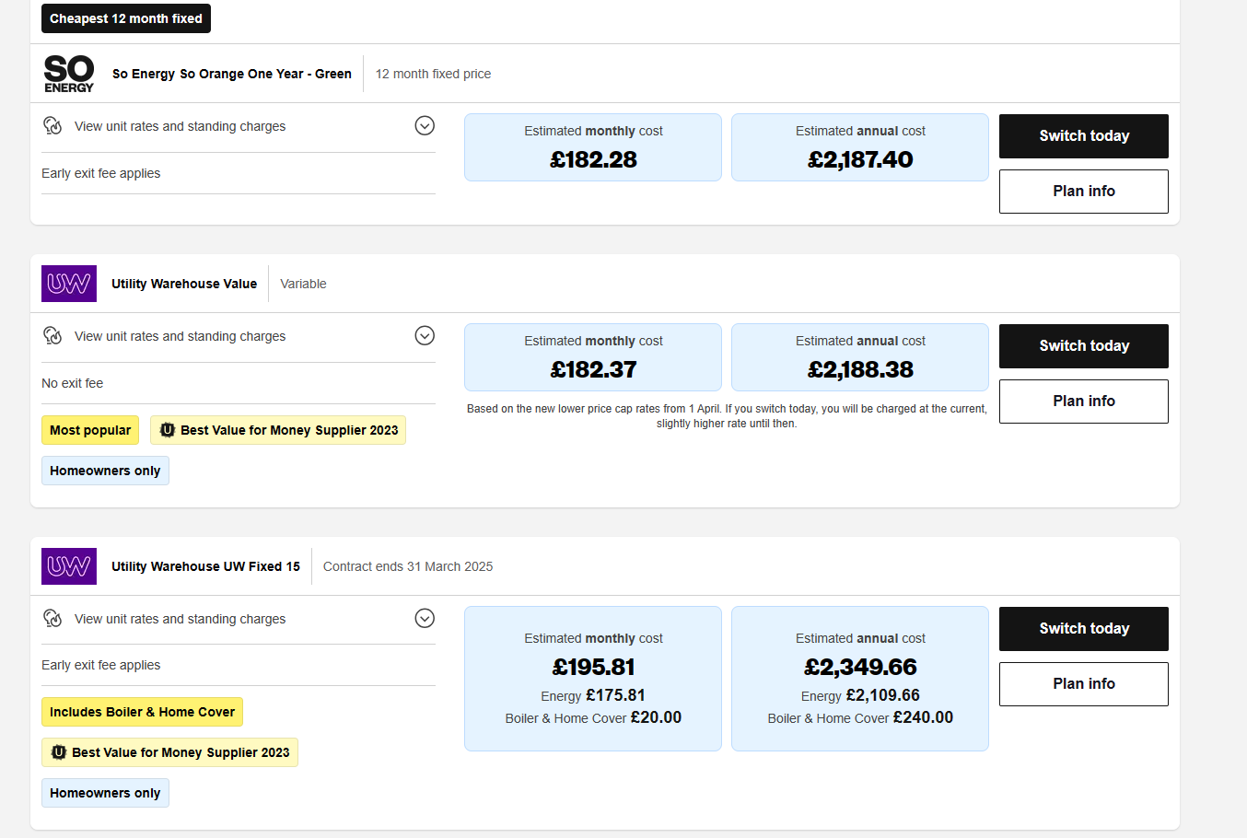

Slide 7
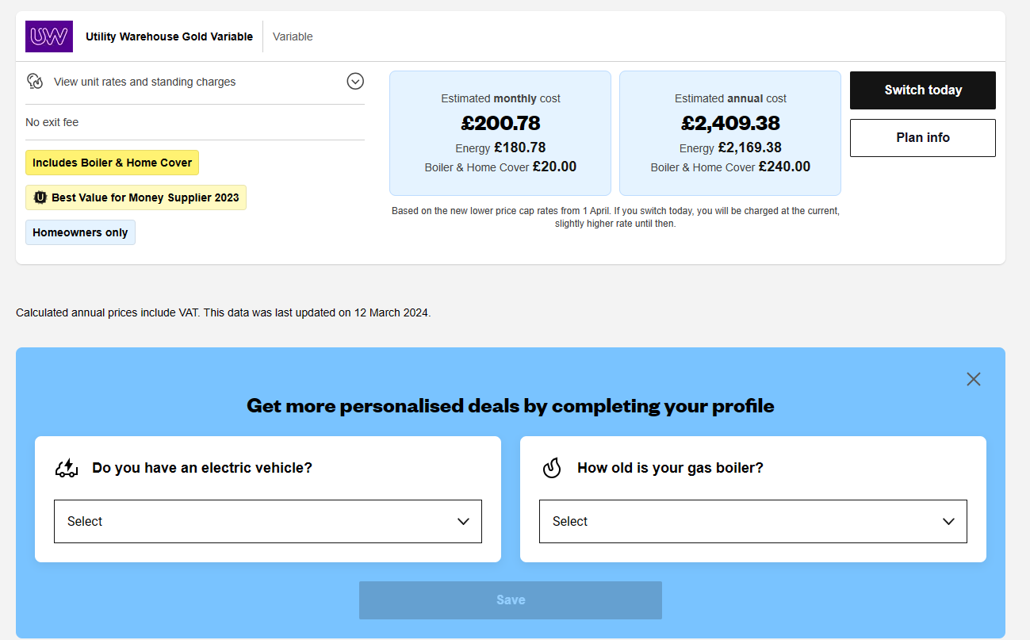
Goals for Q1
Business priorities
Employee opportunities
Increase customer satisfaction by 2%
Maintain growth
Diversify investment in sector 2
Initiative partnership with third-party organisations
End of fiscal celebration on July 15th
Employee day of learning on August 14th
Employee Yoga on September 3rd
Seminar series begins September 10th

Slide 8
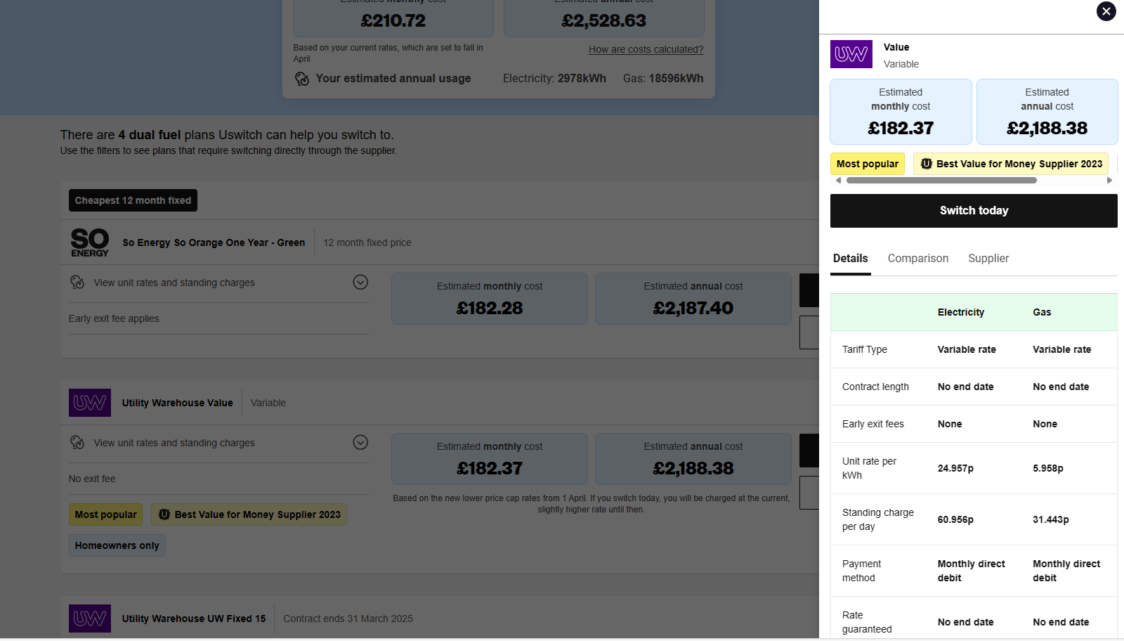
Goals for Q2
Business priorities
Added priorities
Employee opportunities
Increase customer satisfaction
by 2%
Maintain growth
Decrease the number of rotations
by at least 2
Ensure the cost of development stays below budget
Interns begin
Indoor rec leagues
Chess tournaments
Big Game watching party
Food drive

Slide 9
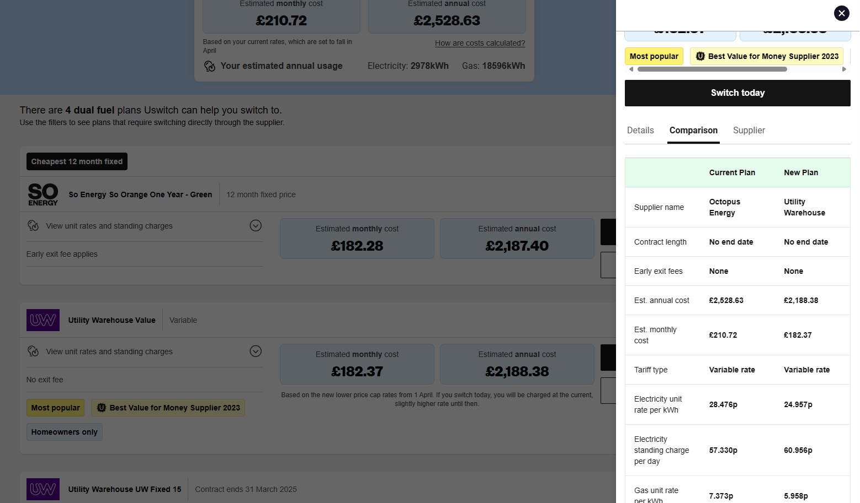
Summary
Our business is good
Our customers keep coming back
Profits are up in the last quarter by 3%
We increased customer retention by 4%
We’re getting our work done
We’re leaders
We finished the consolidation project
We are top leaders in the industry
across the board
We’re delivering for our customers
Last year we supported thousands of customers and
sold 60,000 units

Slide 10

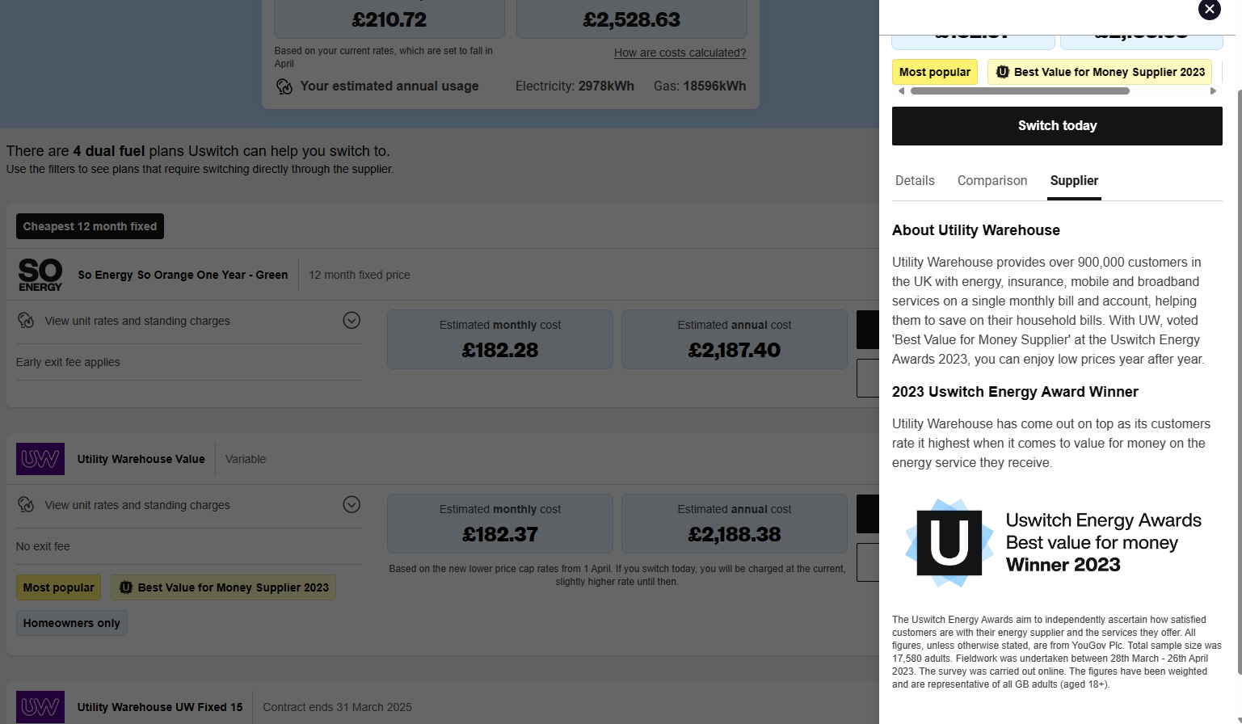
Thank you
Thanks to your commitment and strong work ethic, we know next year will be even better than the last.
We look forward to working together.
Contoso
sales@contoso.com

Slide 11

Utility Warehouse
Why is Utility Warehouse different than the larger suppliers?
They are a multiservice provider
One bill for all of your utilities
Can be fully operated from your app
Cashback card
You can find a local partner to set everything up
You can earn money for referring friends

Slide 12
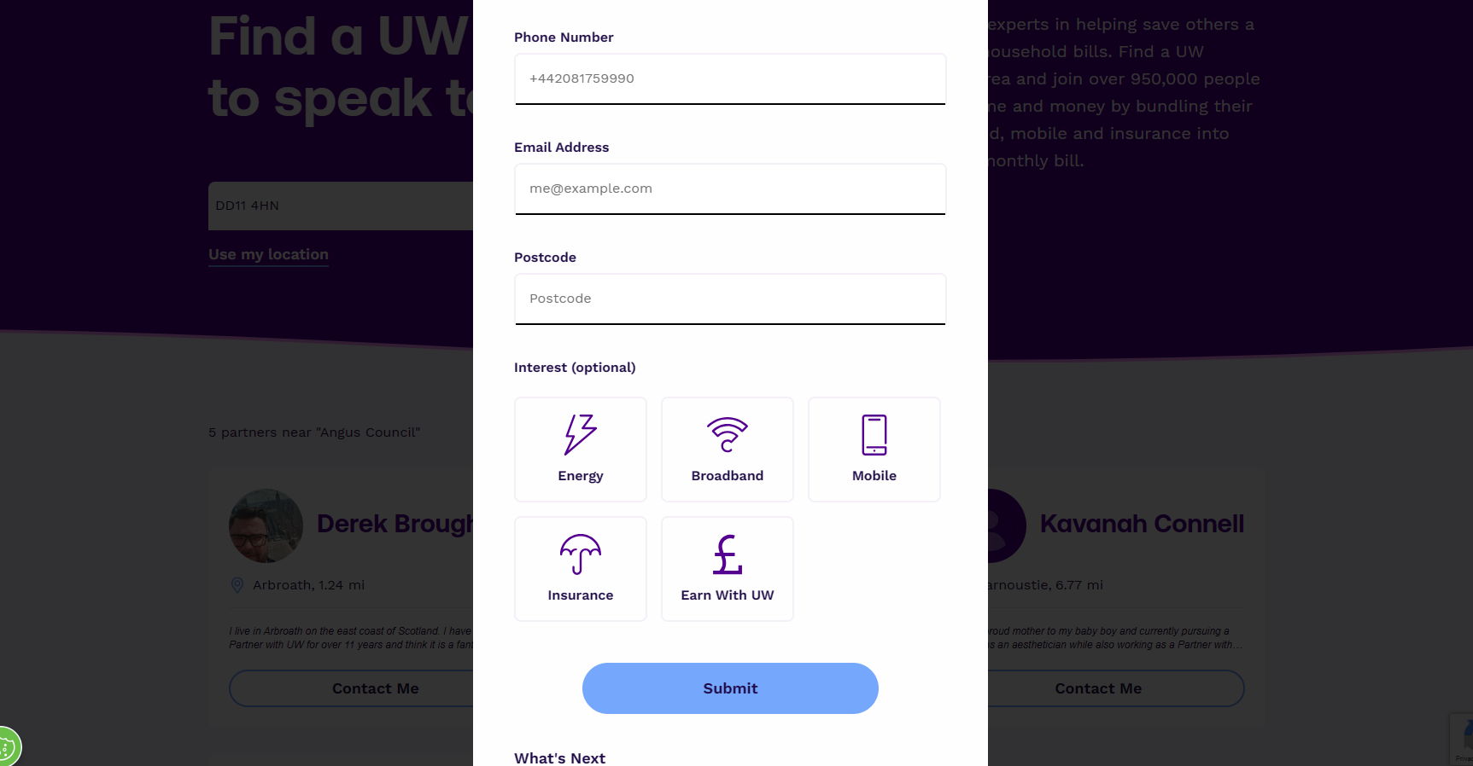

Uswitch
www.uswitch.com/gas-electricity
Put in your postcode and this will find your house and your supplier.
You will need to know which deal you are on with your current supplier
Put in your email address to create an account

Slide 13
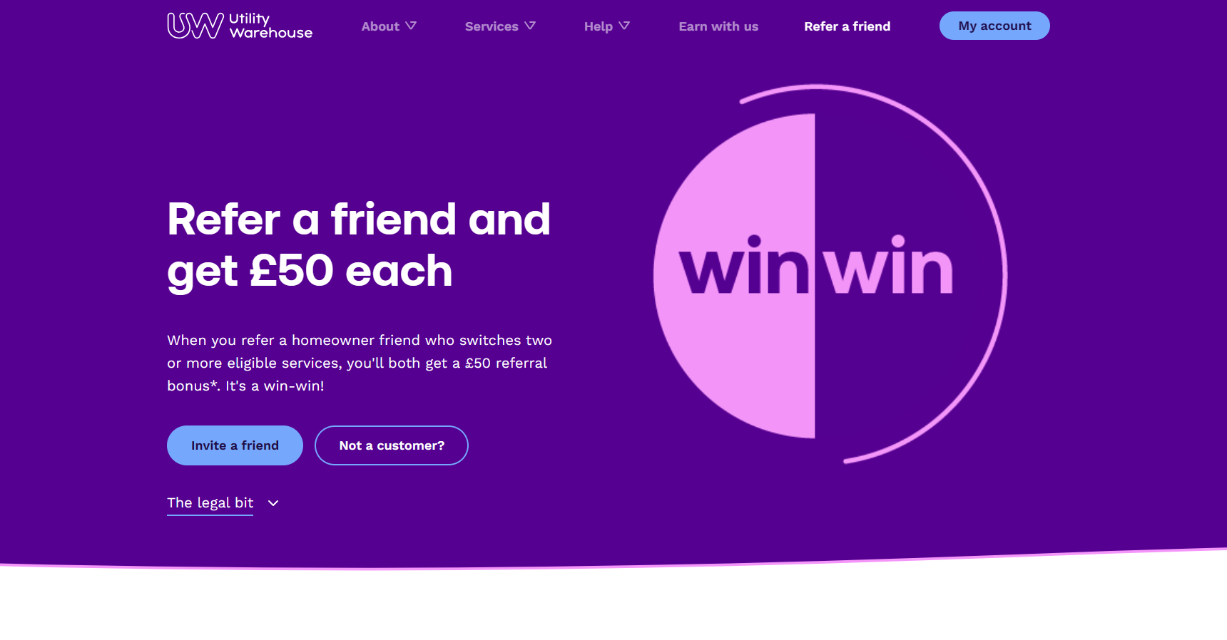
Uswitch
www.uswitch.com/gas-electricity
Put in your postcode and this will find your house and your supplier.
You will need to know which deal you are on with your current supplier
Put in your email address to create an account

Slide 14

Uswitch
www.uswitch.com/gas-electricity
Put in your postcode and this will find your house and your supplier.
You will need to know which deal you are on with your current supplier
Put in your email address to create an account

Slide 15
Resources
The UK Digital Water Utility Experience - YouTube https://www.youtube.com/watch?v=IgbSRKJvbSI
How to choose the best energy supplier - Which.co.uk https://www.which.co.uk/reviews/energy-companies/article/best-and-worst-energy-companies/how-to-choose-the-best-energy-company-aOpXt2w0re4F
Energy Comparison: Compare Gas & Electricity - Uswitch https://www.uswitch.com/gas-electricity/
Webinars - Utility Week https://utilityweek.co.uk/webinars/ How to compare and switch UK electricity suppliers - Uswitch https://www.uswitch.com/gas-electricity/guides/uk-electric-companies/

Slide 16
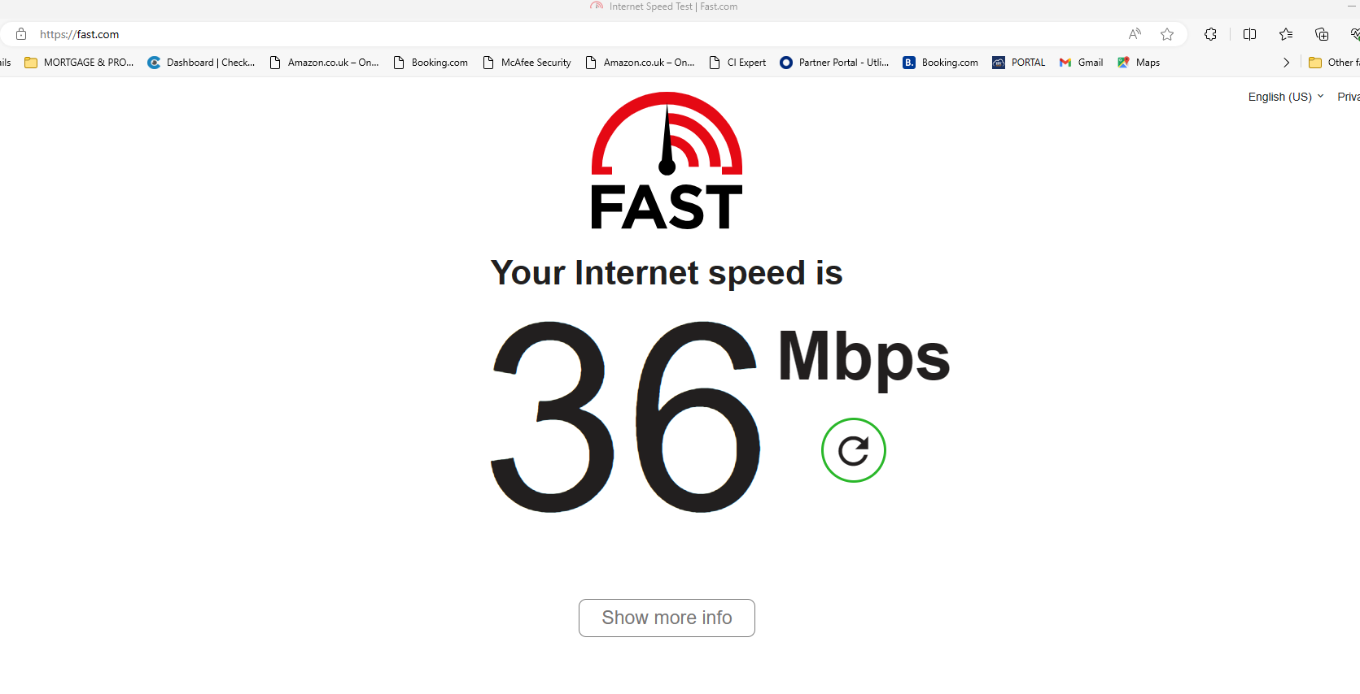
Broadband
Broadband Deals: Compare in March 2024 - Uswitch
Put in your postcode and this will find your house and your supplier.
Check your current speed - Internet Speed Test | Fast.com

Slide 17
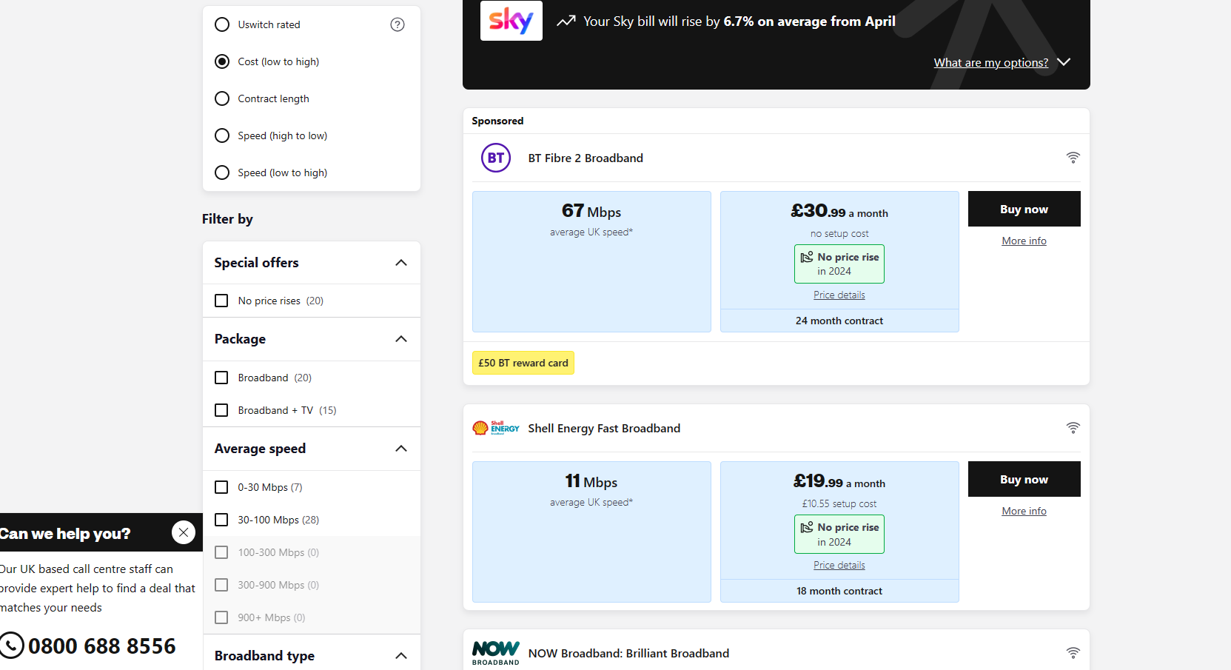
Uswitch
www.uswitch.com/gas-electricity
Put in your postcode and this will find your house and your supplier.
You will need to know which deal you are on with your current supplier
Put in your email address to create an account

Slide 18
Uswitch
Uswitch.com - So many ways to save
Keep in mind that all providers will not be signed up to Uswitch or comparison sites. This is to avoid the commission fees associated with these sites. This allows them to provide potentially lower rates.
Insurance companies who do not use comparison sites
Direct Line
Admiral
Zurich
Saga
It may be worth running a separate quote direct with these insurance companies

Slide 19

Travel Insurance
Uswitch | Travel InsuranUswitch | Travel Insurancece
Whilst searching for travel insurance on comparison sites will save time, it’s important that you understand the level of cover you require, and you declare all medical conditions.

Slide 20
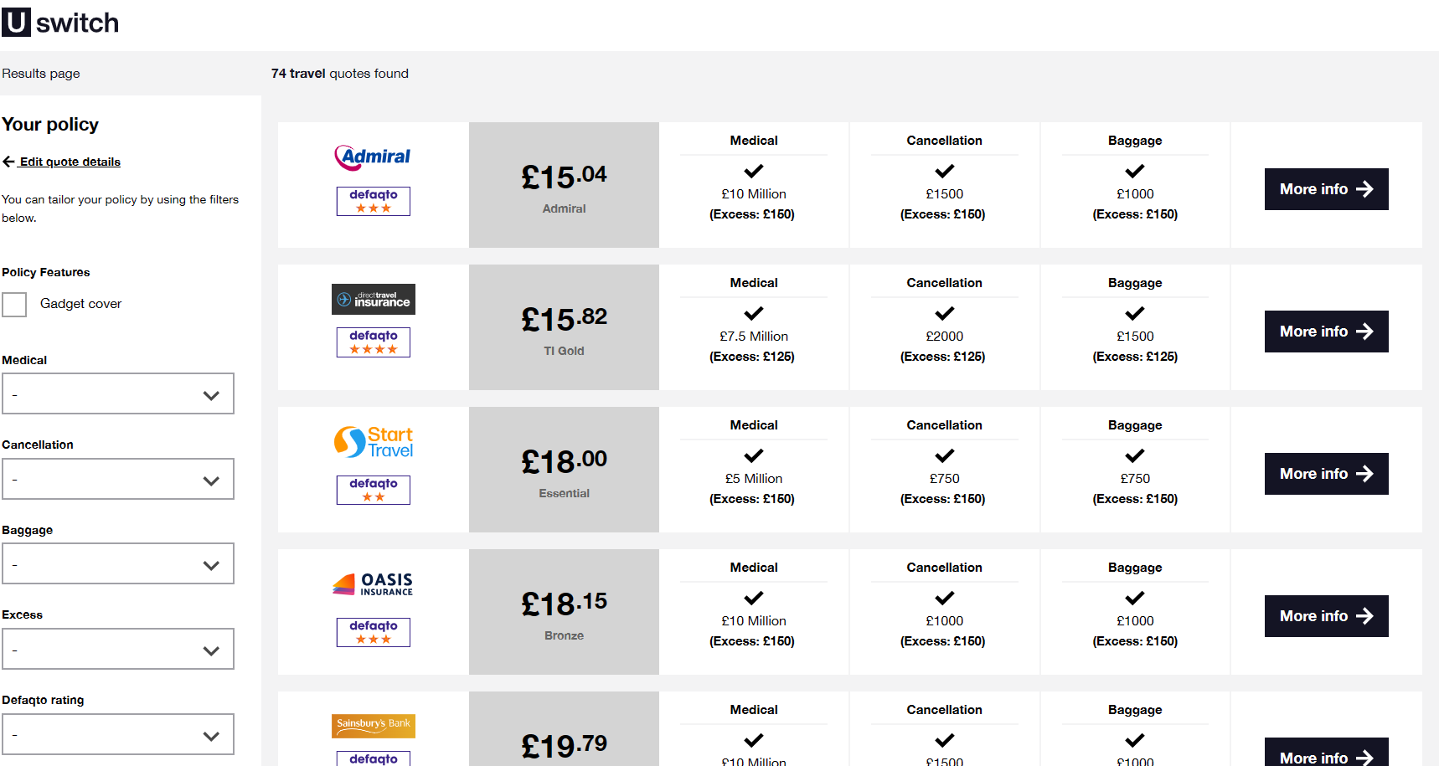
Uswitch
Uswitch.com - So many ways to save
Keep in mind that all providers will not be signed up to Uswitch or comparison sites. This is to avoid the commission fees associated with these sites. This allows them to provide potentially lower rates.
Insurance companies who do not use comparison sites
Direct Line
Admiral
Zurich
It may be worth running a separate quote direct with these insurance companies

Slide 21

Defaqto
Defaqto - helping everyone make smarter financial decisions
Defaqto Rating
Defaqto are a trusted independent research company that rate financial products, the number of stars they give reflects the level of the product
1 Star – provides a low offering
2 Stars – Offers below-average quality
3 Stars –Represents a standard product
4 Stars – Indicates a good product
5 Stars – Signifies an excellent product
This Photo by Unknown Author is licensed under CC BY-SA

Slide 22
Home Insurance
Buildings Insurance: Covers structural damage to your property. - Protects against risks like fire, flood, and subsidence.
Contents Insurance: - Covers personal belongings inside your home. - Protects against theft, damage, or loss. –
Combined Buildings and Contents Insurance: - Comprehensive cover for both your property and possessions. - Offers peace of mind against a range of risks.
Extra Cover –
Accidental Damage – damage that occurs suddenly as a result of something unexpected and non-deliberate
Example – spilling red wine on carpet, foot through the ceiling, nail through a pipe.
Personal Possessions - Personal possessions insurance covers items usually worth less than £1,000 against theft or damage when they're away from home. It could come in handy if you have a valuable item like a mobile phone or a camera that you take outside with you often. Anything over £1,000 should be documented separately.
Home Emergency Cover - helps cover costs for urgent repairs to your main utilities - including water, gas and electricity. You can get it as a stand alone policy or as an add-on to your buildings and contents policy. Sometimes this cover is already included in a standard home insurance policy, but check for this.
Legal Cover Legal cover with your home insurance helps you take legal action in cases concerning: Personal injury, Contracts for goods and services, Property & Employment
Uswitch.com - So mny ways to save

Slide 23

Home Insurance
Impact of Underinsurance:
Financial Risk: Inadequate coverage can lead to out-of-pocket expenses in case of a claim. Rebuilding costs may exceed policy limits, leaving homeowners financially vulnerable.
Emotional Stress: Insufficient cover can cause distress during a claim process. - Inadequate protection can disrupt daily life and cause uncertainty.
Recovery Challenges: - Underinsurance can delay or hinder recovery after a disaster. - Rebuilding or replacing possessions may be difficult without adequate coverage. By understanding the types of home insurance available and the risks of underinsuring, homeowners can make informed decisions to protect their property and belongings effectively.
com So mny ways to save
A significant number of UK homeowners are underinsured. - Many underestimate the value of their possessions or the cost of rebuilding their home.

Slide 24
Underinsurance
As a homeowner, you should know roughly the value of your building and its contents every year.
If your estimates are too low, you could find yourself underinsured.
For example, if your contents are worth £40,000 but you only value them at £20,000 on your policy, you are 50% underinsured. If you were to make a claim, some insurers would only pay 50% of your claim. This means you would have to pay the rest yourself.
Even if the amount you claim is less than the total sum insured, you won't have paid the right premium for the cover you need. So your claims payment may still be reduced.
Having the right level of cover is almost as important as the cover itself. It means if you ever need to make a claim, you won't find yourself at a loss.
Some insurers will pay up to the amount you are insured for. This may still leave you out of pocket. Other insurers offer an unlimited sum insured, or cover you for the rebuild cost of your property. This means that you don't have to worry about being underinsured

Slide 25

Comparison sites – Things to keep in mind
Pros
Saves money
Efficient
Cons
Focus is on cost
Not all providers are listed
Considerations
Efficiency vs Detail – while comparison sites save time, they might not provide all the details needed to make the most informed decisions. It is important to read the terms and conditions before proceeding
Accuracy of information – Ensure all details are accurate, incorrect information can lead to invalid insurance or unsuitable deals.
Use an advisor or a broker for advised products such as life insurance and mortgages, comparison sites are not a like for like replacement for a qualified advisor and important information may be missed.

